Slide 1
Navigating Disaster Insurance
SWLA Staff, SBP
Image: FEMA/Edahl
Notes:
Thank you all for being here today.
This session is getting recorded, so if anyone has to jump early we will be sending the live recording afterwards.
During this presentation feel free to share questions in the chat and we will get to them at the end of the presentation. Also if there’s anyone in the audience that has survived a storm event in the past, please add to the chat measures that you have taken that have worked for you so we can continue to learn and expand our education on disaster preparedness together.
My name is ___________.
I’m SBP’s ___________________________.
My background in ________________ and _______________.
I’m very excited to have the opportunity today to chat with you all about disaster preparedness and key actions that can be taken at the household level to increase personal resilience and be prepared for the next storm. The purpose and the principles behind this presentation are to teach you practices and plans that you can put into place so there’s a more calm and predictable approach to resolving the problems flowing from disasters. If there’s a plan in place and these measures are taken, the impact will be less severe on you and those that you care about.

Slide 2
Today’s Topics:
Knowing the risks
Recovery planning
Getting the right insurance
Mitigation options and insurance
Notes:
Today I will first be going over a brief Prepare Program overview.
Next, we’ll shift gears and talk about building a culture of preparedness. We’ll consider what that really means, how we can integrate building a culture of preparedness into conversations surrounding disaster recovery, and how we can reframe these conversations by expanding upon what’s included in disaster preparedness and planning.
Lastly, we’ll focus on five key actions that you can take to keep you and your family safe during this upcoming hurricane season. These actions include knowing your risks, making a plan, purchasing flood insurance, protecting your important documents, and actions you can take to mitigate risks to your property.

Slide 3
Creating your Preparedness Plan
Step 1: Put together your supplies kit
Step 2: Create your emergency plan
Step 3: Make a recovery plan
Notes:
Use SBP’s resource guide to help create your Emergency Plan. Think through the following questions and considerations with your family when developing your plan.
How you’ll communicate in an emergency. Be sure to think about what happens if you can’t charge or use your cellphone. This might look like ensuring that a portable battery is charged at all times and ready for use, carrying an emergency contact card or arranging an out of town contact to coordinate through.
How to evacuate the house in the event of a fire. You’ll want to practice this, especially if you have small children. Decide on neighborhood and out of town meeting places in advance, and if you need to leave the area, map out evacuation routes and where you’ll go
Think through the safest room in the house to shelter in the event of a tornado or other hazards; and
Plan for any special needs in the event of water/power loss or evacuation.
Practice it with your household and keep it up to date.

Slide 4
Emergency Planning Basics
Supplies
Communication & Information
Evacuation
Sheltering
Notes:
Fortunately, putting together a family emergency plan is pretty easy. Key things you need to plan for are gathering supplies, communication and information, evacuation, and sheltering.
SBP offers checklists and guides with more information on all of these areas. We’ll highlight a few things today.

Slide 5
Step 1: Have a Disaster Supplies Kit
Water: 1 gallon per person, per day Food: non-perishable, easy-to-prepare Supplies for infants, kids, pets Medications & medical items First aid kit Flashlight Weather radio Cell phone with chargers | Extra batteries Multipurpose tool Bedding & blankets Sanitation & personal hygiene items Whistle Map(s) of the area Important documents + photo ID Extra cash
(Source: American Red Cross, Be Red Cross Ready checklist)
Notes:
You’ll want to plan for your needs if you have to shelter at home. Gathering 1-2 weeks worth of supplies is a good starting point, and a go bag in case you need to get on the road (think three days worth of supplies).
Be sure to include specific items for kids & pets, and make sure that you’re including not just the necessities but also comfort items that children, pets, (or yourself) may want in times of distress.
The important step is to have this prepared now, because as we discussed, you never know when disaster can strike.
5

Slide 6
Knowing your risks
Extreme weather events are becoming more frequent
Areas that have never flooded before may have increasing flood risks
Government flood maps are not solely reliable indicators of flood risk
90% of US counties have experienced a flood, hurricane, wildfire, or other calamity serious enough to receive a federal disaster declaration between 2011-2021(Rebuild by Design, 2022).
Notes:
Understanding your risks is a key part of being prepared, and in order to fully grasp your risks, it’s crucial to understand how they are changing. Extreme storm events are becoming more frequent, and places that weren’t currently positioned to be at risk are now increasingly so.
One consideration that I’d like to emphasize is that government flood maps are not solely reliable indicators of flood risks. These maps are not consistently assessed and updated for a variety of reasons, and therefore, if you depend on this information, you’ll be preparing for an outdated level of risk. Because our risks for flood events are changing, we encourage you to keep learning about risks.

Slide 7
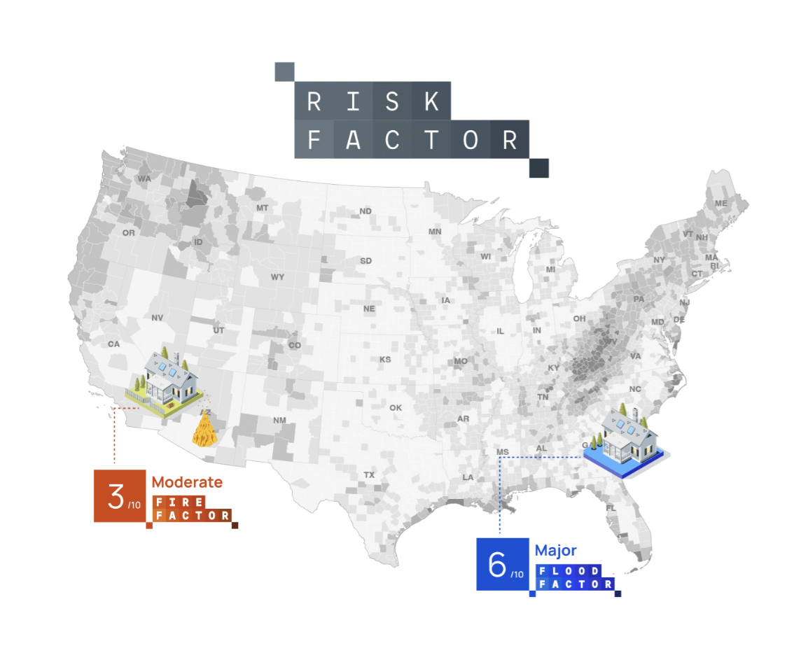
Knowing the Risks
RiskFactor.com
Notes:
We recommend using a really great tool called riskfactor.com which was developed by the First Street Foundation and with this tool you and your household members can go in and type your address or zip code to see what your area’s current and future risk is. While your personal experiences with any past flooding have certainly given you a lot of information about what areas are most vulnerable, it’s important to remember that future floods may affect communities in different ways.
A key takeaway point that I hope really drives the importance of understanding your risk is that most states do not require home sellers to disclose past flooding to their homes. It is up to YOU to understand your flood risks and get prepared.

Slide 8
Federal Disaster Aid
Qualifying:
Limited access to repeat aid
Limitations:
Not every disaster will be big enough to trigger a federal disaster declaration
Even when available, federal disaster assistance grants are limited (some may take extended time to become available)
Personal preparedness is critical because federal assistance is not guaranteed
To learn if there are any insurance mandates for your property: contact FEMA at (800) 621-FEMA or floodsmart@fema.dhs.gov
Notes:
If a household received disaster aid (including current and previous occupants) and did not maintain flood insurance, that household will not be able to apply again unless insurance coverage has been maintained for a “like” event
It’s important to understand that federal disaster assistance is limited. Federal disaster assistance is also not guaranteed. Once you receive federal disaster aid, you can’t receive it again unless flood insurance is maintained. That is just another reason why it’s absolutely a top priority to set yourself up for success in terms of getting the right insurance.
This is why financial preparedness and having the right insurance is so important.

Slide 9
Appealing Disaster Aid Decisions
Encourage community members to appeal FEMA decisions if they have experienced a disaster and qualified for federal aid, but are dissatisfied with the amount awarded.
Learn more about SBP’s FEMA Appeals Program: https://sbpusa.org/our-mission/advocate/fema-appeals-program
Results: Survivors see a 65.7% increase in their total FEMA award
Survivors are awarded $7,992 in additional FEMA funds to support their recovery
Maximize FEMA award amounts!
Notes:
*If applying for disaster aid is a viable option for you
If you qualify for disaster aid, appeal your award amount to make sure you are awarded as much money as possible. This is likely your only opportunity to rely on disaster aid, unless you purchasing insurance coverage for your property in future, in which case, you can qualify for disaster aid again.

Slide 10
Protecting Household Finances
Those with insurance recover faster and better than those without insurance
The average FEMA disaster assistance grant is only $5,000 per household, but the average flood insurance payout is $69,000.
Notes:
At SBP, we advocate for everyone to have flood insurance coverage. Insurance is actually cheaper for those outside mandatory purchase zones. Still at risk because of what already mentioned that flood maps not accurate. Just as important to purchase insurance if you have risks according to riskfactor.com
Statistics: Disaster Assistance vs. Flood Insurance: Do You Know the Difference? (fema.gov)

Slide 11
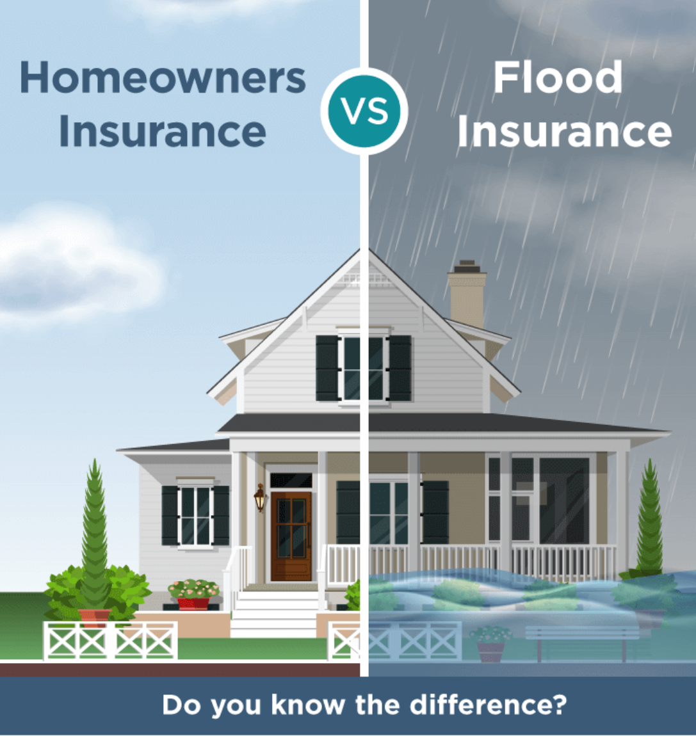
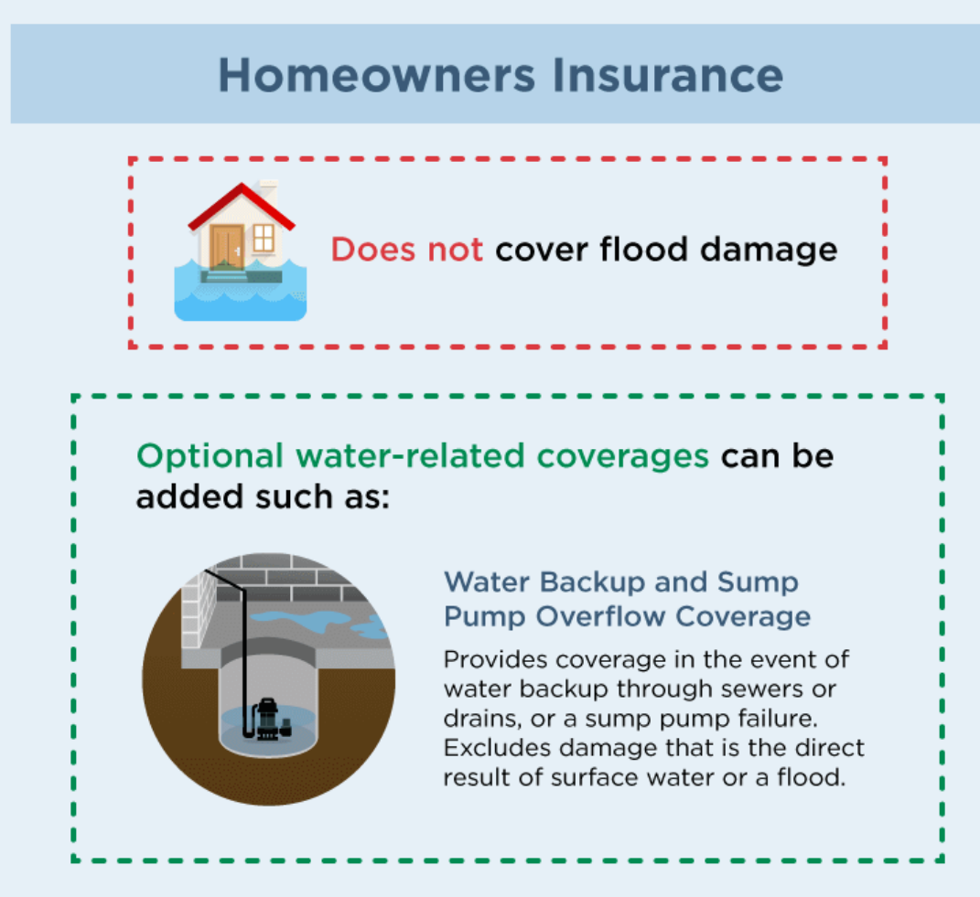
Flood Insurance vs Home Insurance

Slide 12
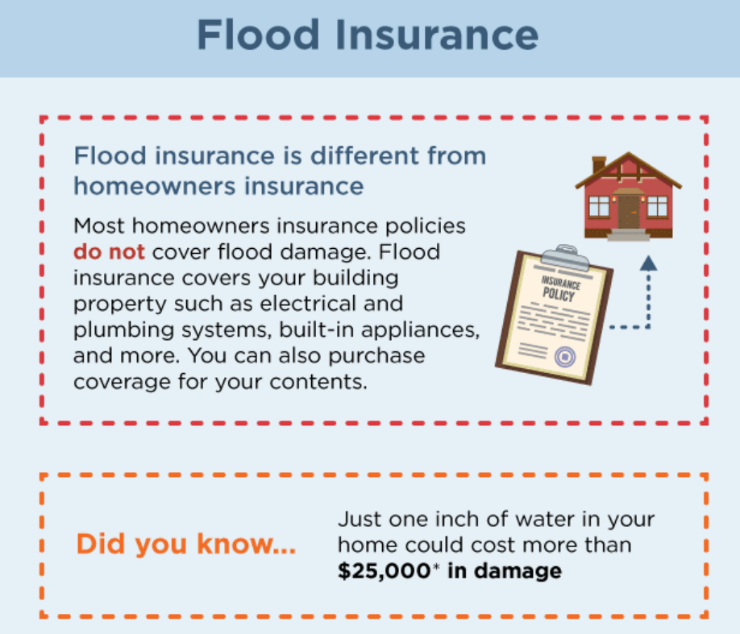
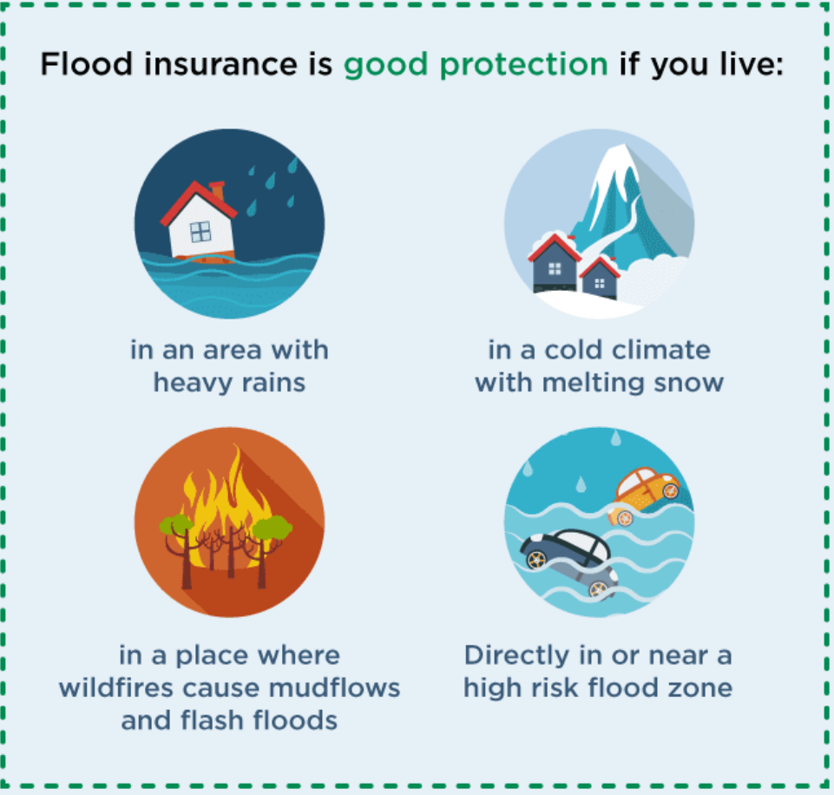
Flood Insurance:

Slide 13
What’s in a Policy?
Homeowners Insurance
Standard Parts:
Dwelling
Other structures
Personal property
Loss of use
Personal liability
No-fault medical
Policy Types:
Named Perils
“All-Risk”
Coverage Value:
Replacement Cost
Actual Cash Value
Renters Insurance
Notes:
As of 2020 according to the INsurance Information Institute, the average homeowners policy cost $1500 in AL
It’s important to know the basics of what’s in your insurance policy. These are the standard parts and what you’ll have coverage for. For renters, know that your landlord’s insurance will only cover the structure of your apartment building or rental home—not the stuff inside that you own. You’ll need your own renters insurance policy.
Know your policy type. Named peril policies mean you’re covered for losses resulting from the perils specifically listed in your policy and nothing else. All-risk policies cover you for any accidental cause of loss EXCEPT those specifically excluded in your policy.
It’s also critically important to know if you have replacement cost coverage—which will give you enough to replace lost items with those of a similar kind or quality—vs. actual cash value, meaning the value of your items less depreciation, which won’t be enough if you need to replace them.

Slide 14
What’s Not?
Common Exclusions:
Flood
Drain/sewer backup
Ordinance or law
Pest damage
Earthquake
Natural wear and tear
Pipes freezing
Collapse
Continuous water seepage
War
Notes:
All risk policies have exclusions. Exclusions are policy provisions that waive coverage for certain types of risks or events. Unfortunately, many people are unaware that they aren’t already covered for flooding by their existing homeowners or renters policy. Many people are also unaware of the importance that they get covered. It is crucial to take time to understand exclusions in your policy. Don’t be afraid to ask questions and go back to your agent for more details and clarification. Don’t be afraid to ask another trusted source for a second opinion. What matters most here is your understanding, making sure that you’re purchasing exactly what you think you’re purchasing. This is a priority, and while it’s time consuming, it won’t cost you anything to have these conversations to truly understand what is and what isn’t in your policy.

Slide 15
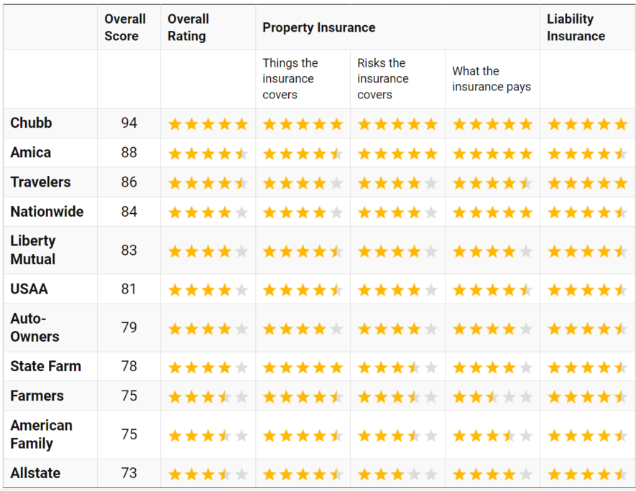
Homeowners Insurance Policy Scoring Tool
Created by the Rutgers
Center for Risk and Responsibility, the Homeowners Insurance Policy Scoring tool — RU InsureScore — evaluates important elements of each company’s policies.
Access the tool at:
https://crr.rutgers.edu/homeowners-insurance-policy-scoring-all-tables/
Notes:
Using this online tool you can look at individual pros of policies provided by each company, as well as things to watch for related to property insurance coverage.

Slide 16
Flood Insurance
Flood losses are not covered by homeowners or renters insurance policies
Flood insurance is available for homeowners and renters
Everyone with any flood risk should have flood insurance, including outside the mandatory flood insurance zone
Source: https://www.fema.gov/data-visualization-floods-data-visualization
Notes:
The national flood insurance program offers most policies in the US. As federal dollars come in, we’d encourage you to think about how money can be used to help subsidize covering part of or the full cost of policies for the most vulnerable people.
Your homeowners or renters insurance policies do NOT cover flood losses. It’s important for everyone, including those outside the mandatory flood insurance zone, to get flood insurance.

Slide 17
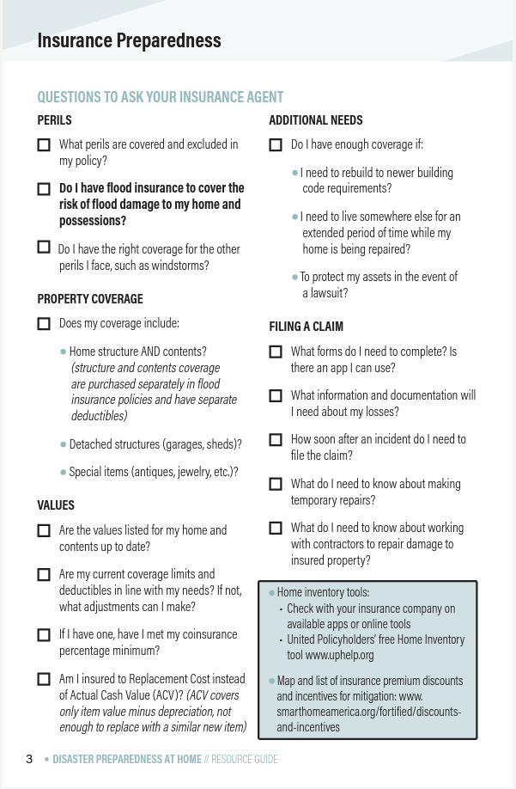
Flood Insurance
Ask insurance agents about:
National Flood Insurance Program policies (anywhere between $225-$2,296 is the average monthly premium)
Private flood insurance options (both partial and full coverage) in Louisiana
Notes:
I encourage you to speak with your agent about National Flood Insurance Program policies and private flood insurance options in your state, options with both partial coverage and full coverage to know and really understand what you have available to you.

Slide 18
Insurance Preparedness Checklist
Check if homeowner’s or renter’s insurance policy covers flood
Save for deductibles
Set aside emergency cash
Make a home inventory
Home Inventories should include:
Pictures and videos of the home and belongings
Important receipts, ownership papers
The value of one’s belongings and what it would likely cost to replace those items
Store inventory lists safely!
Notes:
Our action items here as it relates to financial preparedness are as follows: first and foremost check to see what is and isn’t covered by your homeowners or renters insurance, make sure you really understand your coverage, and make any necessary changes to ensure that your coverage is sufficient, save money so you can meet your deductibles (which are the amount you are committing to pay out of pocket toward an insured loss), set aside emergency cash, and make a home inventory. I know that that’s easier said than done, especially with inflation it’s hard to even go to the grocery store without spending more than you’re planning to. So I’m not saying this lightly. One suggestion here is to automatically transfer money to an emergency savings account every Friday, once a month, whatever works for you so you never see it and cannot touch it. This will provide a sense of peace and stability during your recovery. The sacrifice now could provide peace of mind later knowing that these measures are in place, but I know that in this financial climate it’s not easy to save money, so I’m again not saying this lightly. It’s certainly a tradeoff.
If you take these actions, you will be financially protected during the next storm event.

Slide 19
Insurance Claims Concerns
Contact:
National Flood Insurance Program (NFIP)
1-888-FLOOD29 or 1-888-356-6329
www.floodsmart.gov
Consumer Services Division
within Louisiana’s Department of Insurance
https://www.ldi.la.gov/onlineservices/ConsumerComplaintForm
United Policyholders
https://uphelp.org/
A nonprofit whose mission is to be a trustworthy resource and voice for consumers of all types of insurance in all 50 states
Tip: Emphasize the importance of not rushing to agree to a settlement amount.
If a household cannot come to agreement with the adjuster and/or claims department, advise that they contact Louisiana’s Department of Insurance.
Notes:
Reach out to consumer protection within state insurance offices if you’re having issues with a claim.
I encourage you to check out Louisiana’s Dept. of Insurance website for insurance questions or concerns through the Consumer Services Division, but also to spend time browsing through the DOI website as there are a lot of great resources and tools including a entire section on disaster preparedness. Includes info such as: community tips, important documents tips, personal and property tips, contact numbers and insurance claims hotlines, emergency adjuster information, and much more!

Slide 20
How are Rates Determined?
Factors include:
Flood risk (e.g., flood zone)
The type of coverage being purchased (e.g. building and contents coverage)
The deductible and amount of building and contents coverage
The location of the structure
The design and age of the structure
The location of the structure’s contents
Notes:
A number of factors are considered when determining your annual flood insurance premium.

Slide 21
Mitigation Options and Insurance
Benefits of implementing mitigation options:
Reduction of risks
Reductions of insurance costs
*Encourage households to ask their insurance agents what mitigation options count for premium reductions to policies!
Get your Elevation Certificate
Elevation certificates document the elevation of a building and having one is one of the easiest ways to reduce insurance premium cost.
Notes:
The relationship between mitigation options and insurance is another critical area to cover with your community and network. Encourage your audience to keep in the back of their minds that mitigation actions may lower insurance costs and may result in tax deductibles in some states, so as you share some of these options urge your audience to not automatically write them off if they sound cost-prohibitive at first blush. Empower your audience to do a little research and see what their state offers. These mitigation actions just may be more affordable than your audience may realize!
It’s easily digestible to about it like this: insurance costs are tied to risks. So, if you introduce mitigations measures to your property, not only are you safeguarding your house from future storms, but you’re also lowering your risk, and therefore lowering your liability to your insurance company, meaning that you’re reducing your insurance costs. Examples of these options are raising mechanicals (such as heating and cooling systems, water heaters, electrical panels, and other utilities), installing flood openings, filling basements, elevating properties (and providing an elevation certificate), and relocating.
Stress to your audience the importance of getting elevation certificates:
Get your Elevation Certificate
Elevation certificates document the elevation of your building for the floodplain managers enforcing local building ordinances and for insurance rating purposes. While no longer required for purchasing a federal flood insurance policy, getting your elevation certificate is one of the easiest ways to reduce insurance premium cost. Learn more at www.floodsmart.gov/elevation-certificates
Additionally, promt your community to have conversations with their insurance agents on what mitigation options count towards premium reductions.

Slide 22
Louisiana Examples
Mitigation Insurance Discounts and Tax Credits in Louisiana:
FORTIFIED Roof Endorsement
Retrofit Tax Deduction-$5,000 Max
*Must comply with the State Uniform Construction Code
https://www.smarthomeamerica.org/
Notes:
https://www.ldi.la.gov/consumers/insurance-type/homeowners/hurricane-resource-center/storm-mitigation-incentives

Slide 23
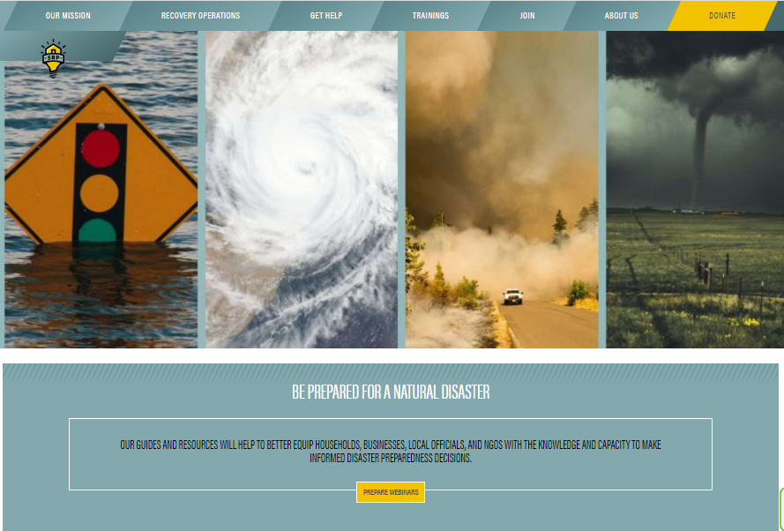
Preparedness and Recovery Resources
Visit sbpusa.org/prepare-natural-disaster
Download the Equip app
SBPUSA.org/EQUIP
Notes:
In addition to our trainings, SBP has build out great resources in the form of written guides, checklists, short videos, and elearnings on both preparedness and recovery topics.
These are all available to download from SBP’s website, as well as accessible via our phone application Equip, from which households can track their progress through various preparedness activities or get guidance on different parts of the recovery process.
Through SBP’s prepare program, we will be building out new resources that will be released through these platforms in the coming months.

